Slide 1
Fast Food Concerns
Yan Xu, Jinwoo Oh, Matt Hawley

Slide 2
Agenda
Starting Observations
Objectives
Data Source
Data Cleanup & Exploration
Data Analysis
Limitations
Summary
Notes:
Matt: Illustrate Slides 1-5

Slide 3
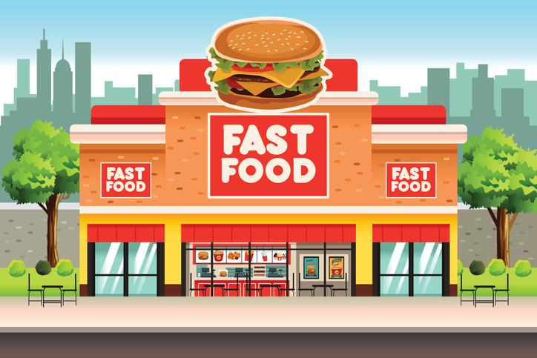
Starting Observations
Fast food is cheap, convenient, and generally unhealthy.
How else does fast food consumption affect American society?
Notes:
A common American belief is that fast food is cheap, convenient, and generally unhealthy.
Although poor health of citizens can strain society, we have little research on the effects of fast food consumption on other areas of society.
Some patterns we considered before researching:
suburban communities such as the Woodlands appear to have mostly national franchises, whereas urban communities such as those inside loop 610 have a lower ratio of chains to locally owned restaurants.
Although more populated areas are expected to have more restaurants in general, metropoles usually (if not always) include multiple zip codes. In fact, zip codes are often segregated by income level. Therefore, the assumed correlation between population and number of restaurants may hold interesting intricacies.
Several restaurants include promotional deals based on the success of professional sports teams. Perhaps significant sporting events affect rates of consumption.

Slide 4
Objectives
Compare the number of fast food restaurants with:
crime rate
income level
education level
population
Does an area with a high number of fast food restaurants also have:
a high crime rate?
low income levels (median, mean)?
few citizens with advanced degrees?
high populations?
Notes:
Ultimately, the datasets that are accessible to us are crime rate, income level, education level, and population. To consider the amount of fast food consumption, we decided that the number of fast food restaurants is a sufficient measurement for the size of this project. Although it is difficult to determine whether an area with 1 or 2 more restaurants than another area eats more fast food, we can safely make this assumption for areas that differ by 5 or more restaurants.
Therefore, our analysis will compare the number of fast food restaurants in a single zip code to the zip code’s crime rate, income level, education, and population.

Slide 5
Data Source
Fast Food Restaurants Across America at Kaggle.com
United States Crime Rates By County at Kaggle.com
US Household Income Statistics at Kaggle.com
Graduation Rates at Opendatanetwork.com
Notes:
The fastFoodRestaurants dataset includes 10000 restaurants from 548 types/brands in USA

Slide 6
Data Cleanup & Exploration (General)
Removal of duplicate and invalid data
Reorganize (Pandas)
Data Conversion (Zip code to County and State)
Specific datasets:
Jinwoo - Crime Rate
Matt - Income
Yan - Education, population
Notes:
At first we thought we should merge all of our datasets into a single dataframe to ensure that all of the data came from the same zip codes. In other words even though we are limited to the 10,000 or so zip codes included in the fast food set, some of those zip codes are not included in the other data sets. If we had merged all of the data sets together, our final dataset would have included around 3,000 zip codes - one quarter of the size of the available data.
Although we did not need to merge all of our datasets into a single dataframe, we learned a lot about our data by completing this task. For example, converting 9 digit zip codes to 5 digits creates duplicate zip codes, some of our datasets had multiple entries for the same zip code, some counties looked like they were misspelled but actually came from different states, crime data is aggregated by county, never by zip code (who knew?)
To incorporate the crime data, we needed a way to group our fast food restaurants by county and specify the state, since multiple states could have similar county names. Conveniently, USZipCode is a python library that includes a database of zip codes and more-or-less relevant information such as as county, state, latitude and longitude, population, total land area, total water area, and even reasons for house vacancy. We were able to create unique ids by using the state, county, and zip code and use these ids to calculate the number of fast food restaurants in every county and every state.

Slide 7
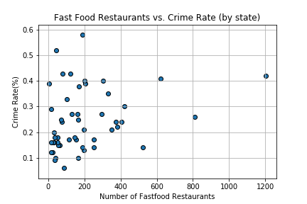
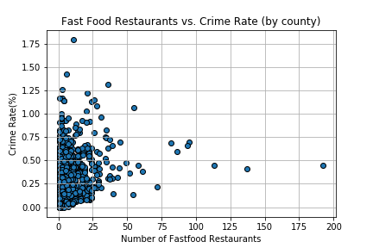
Data Analysis: Fast Food vs. Crime Rate
Notes:
Jinwoo
Why is Crime Rate not a percentage?
Why is Crime Rate not by Zip Code?
Why did we change the data?
Why are scales different?

Slide 8
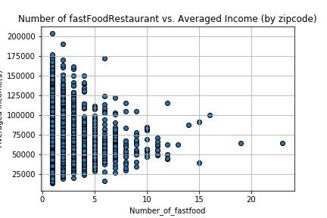
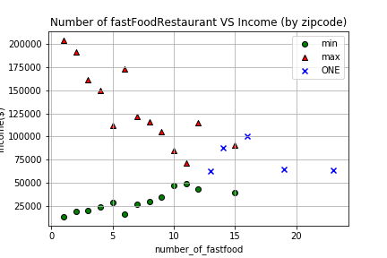
Data Analysis: Fast Food vs. Income Level
Notes:
Matt
Why did we change the data?
The highest income values reported by the dataset are $300,000
Much of the income data included duplicate, sometimes conflicting data. For example, there were 5 different entries for 99701 in Fairbanks, Alaska, with wildly different median and mean incomes, latitudes and longitudes.
No information was included about the number of people surveyed in each area.
I came up with 2 options to resolve this conflict. In order to create a list of unique Zip Codes 1) pick one randomly (groupby zip code and use .first()) or 2) average the data. Our group decided averaging the data involved the least interference.
“Meaning of results”
According to this data, both wealthy and mean communities have few fast food restaurants

Slide 9
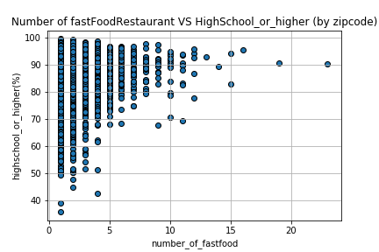
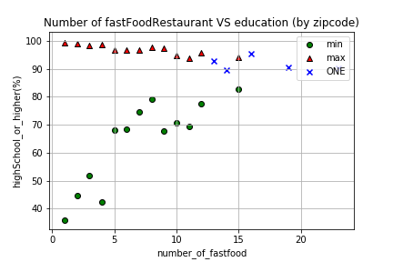
Data Analysis: Fast Food vs. Education Level
(high School or higher)
Notes:
Yan

Slide 10
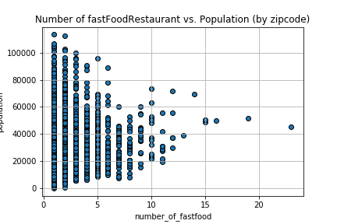
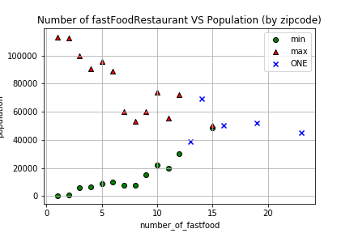
Data Analysis: Fast Food vs. Population
population
population
Notes:
Yan

Slide 11

Limitations
Difficulties & Challenges
What would we have done differently if we have two more weeks?
Notes:
challenges:
Fast food data was by far the smallest dataset.
Next steps:
Compare housing prices with fast food data
Investigate why there are so few zip codes with more than 10 fast food restaurants:
Was the zip code excluded from certain datasets?
Investigate if there is a reason that all of our plots have a similar triangle shape?
Eagerly await the reactivation of data.gov

Slide 12
Summary
Fast Food Restaurants vs. Crime rate
Fast Food Restaurants vs. Income level
Fast Food Restaurants vs. Education level

Slide 13

Q&A

Slide 14
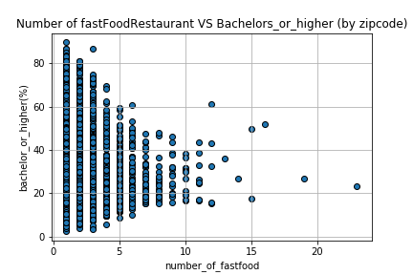
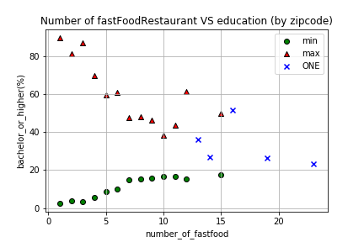
Supporting information
Data Analysis: Fast Food vs. Bachelor degree or higher

